Slide 1


Evaluating Fire Risk in existing Buildings
Presented by
National Association of State Fire Marshals

Slide 2


OVERVIEW
This course discusses the basic concepts of fire safety assessment and evaluation of buildings.
Evaluation and Considerations
  Layers of Fire Protection Analysis (LOPA)
  Fire Risk Indexing
Assessment Methodologies
  International Existing Building Code
  NFPA 101A
Notes:
<Total Clicks: 2> Overview of the course content.
Fire safety assessment and evaluations of buildings, including:
<1> The methods available to conduct these evaluations: Layers of Fire Protection Analysis (LOPA) and Fire Risk Indexing. Each method considers the presence of layers of protection (safety layering) and evaluates the fire safety attributes of each building in relation to the risk that the occupancy presents.
<3>We’ll review two widely used methodologies for assessing existing buildings: Chapter 14 of the International Existing Building Code (IEBC) and NFPA 101A, the guide to alternative approaches to life safety.
Each of these documents provides a roadmap for the evaluation process.

Slide 3


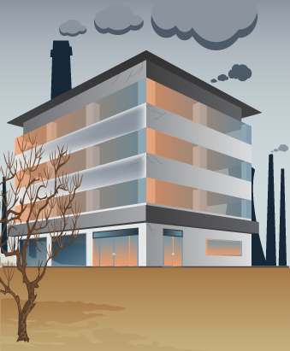


Well-kept
Neglected
Complies with current construction codes.
Does the building’s relative level of safety ever change?
Our codes and standards change
as we develop new protection strategies.
Notes:
<Total Clicks: 1> The relative safety of a building.
We can safely assume that a building is constructed in compliance with current regulations. Does the building’s relative level of safety ever change?
Often, the building or its systems are allowed to deteriorate, or unexpected hazards are constructed adjacent to the building. On the other hand, if the building is maintained well, and surrounding buildings don’t pose an additional threat, then the level of safety will remain stable. However, society’s expectations change over time, and it’s likely that a building constructed many years ago will not include all of the safety attributes expected in a new building.
<1> As time progresses, we gain a better understanding of the hazards presented, and develop new methods to address some of those hazards; thus, our codes and standards change as we develop new protection strategies.

Slide 4
Basic Concepts
Do existing buildings have to comply with new codes and standards?
Answer
Rarely.
Does the acceptable level of risk ever change?
Answer
Yes.
Notes:
<Total Clicks: 3> Do existing buildings have to comply with codes and standards, and does the acceptable level of risk ever change?
Since codes and standards change throughout the life of that building, do existing buildings have to comply?
<1> Not normally; generally, public policy dictates that a building that was compliant with a jurisdiction’s regulations at the time of construction does not have to be updated to later versions of the codes. On a rare occasion, jurisdictions and the model codes identify a risk that is unacceptable, even in existing buildings. These risks are then mitigated using retroactive requirements. These are rare, but important events.
<2> So, does the “acceptable” level of risk ever change? In other words, does the expected standard of safety change over time?
<3> Absolutely. And the change may be to a safer environment or, in rare instances, we have actually seen changes to a more hazardous condition.

Slide 5





“All concrete and steel constructions with no combustible contents, and everything needs a sprinkler system.”
“No regulations!”
Minimum Level of Safety
Members of the community should determine the level of safety they are willing to:
Engineers
Fire Fighters
Elected Officials
Risk safety based on mathematical equations
Absolute
safety
What is the acceptable level of fire safety?
Most
Common
Based on
the business owner
Accept
Pay for
Loose Standards
Strict Standards
Notes:
<Total Clicks: >
<1> Let’s examine that idea a little deeper. What is the acceptable level of fire safety?
It depends who you ask.
<2> One city manager philosophized that if he agreed with the fire marshal all the time, nothing would ever be built in his city because it would all be concrete and steel construction, with no combustible contents, and everything would have a sprinkler system; but, if he agreed with his economic development manager all the time, the city would burn down because there would be no regulations. His perspective was that the two department heads were a good check and balance system for the community.
<3> In most communities, the members of the community should determine the level of fire safety they are willing to accept and are willing to pay for. One problem is that the general public doesn’t have a good understanding of fire dynamics, the speed with which fire spreads, and the limitations of responding fire suppression personnel. So, they depend upon their fire department personnel to help them with the decision. By doing this, they assume that any building they are in is “safe”, and they don’t fear that the building will catch fire, or that they will be trapped should a fire occur. The public has a great deal of trust in the fire service, and it’s up to the fire service to maintain that trust.
<4> The codes and standards organizations attempt to codify the level of safety from most communities in the U.S. You might consider the codes being developed to fit within a bell curve that reflects the levels of safety across the country, so that the model regulations fit most communities, but not all. This becomes the defacto “minimum” level of safety consistent with the national standard.
<5> Professional opinions as to the appropriate level of safety are as varied as the professionals and their professions. Engineers sometimes are willing to shave the safety factor in fire protection systems, depending more upon their mathematical evaluations than others; firefighters and fire prevention officers sometimes want “absolute” safety, which can’t be provided; elected officials are sometimes willing to accept the level of safety that the building owner wants to provide, regardless of regulations or other factors.
These are the issues that need to be addressed through robust communications between all stakeholders, and it’s important to consider all positions when moving through a fire safety assessment of a building.

Slide 6
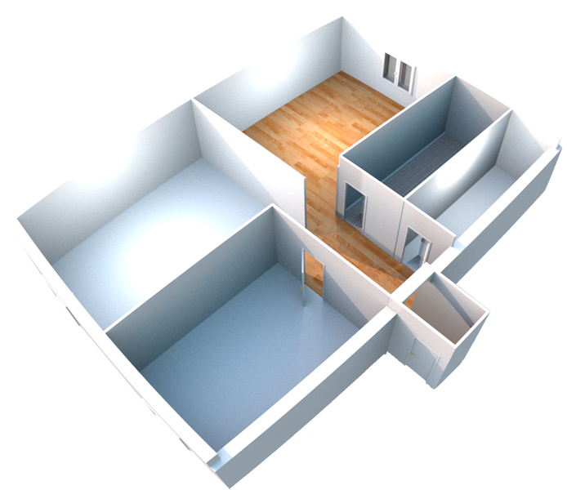







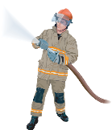
Economic risk
Risk to citizens
within or in proximity
to the building
Risk to firefighters and other emergency workers
Fire safety assessments identify strengths and weaknesses in a building’s fire protection scheme.
Notes:
<Total Clicks: 3> Fire safety assessments and types of risks.
Fire safety assessments are intended to identify strengths and weaknesses in a building’s fire protection scheme. In order to conduct such an assessment, it’s important to consider several different factors.
One factor is the level of risk that a particular property presents.
The risks can be divided into three categories:
<1> Risk to citizens in the building, or adjacent to the building, that would otherwise be affected because of their proximity to the building
<2> Risk to Fire fighters and other emergency workers responding to an emergency in the building, and
<3> Economic risk related to the value of the building, the business operating in the building, and the economics to the community.

Slide 7

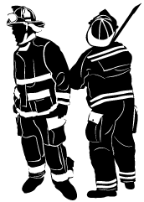
Citizens
Firefighters
All fire safety assessment should begin by identifying the property’s risks.
Opportunity for survival
Evacuation
Rescue or Suppression Operations
Notes:
<Total Clicks: 3> Assess risks to provide everyone with an opportunity for survival.
When assessing these risks, life safety is paramount.
<1> Citizens should be able to depend upon a level of safety that provides them the opportunity for survival should a fire occur and they take appropriate action, such as evacuating the building.
<2> Firefighters should be able to depend upon their training and assessment of a building to determine whether they will conduct interior rescue or suppression operations without unexpected building collapse or other catastrophic event that jeopardizes their safety.
If a business is critical to the economic well being of a community, the citizens should expect that safeguards be in place to avoid that business suffering a loss that would put them out of business or cause them to shift the operations to another community.
<3> Any fire safety assessment should start with an identification of the risks associated with the property being assessed.

Slide 8

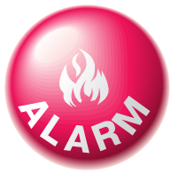

Most facilities need several layers of fire protection to achieve the desired level of safety.
Fire Alarm System
Enhanced Egress System
Notes:
<Total Clicks: 1> Fire safety features as layers of protection.
Once we’ve identified a building’s risks, we need to assess its fire safety features.
Each fire safety “feature” can be viewed as a “layer” of fire protection. Rated construction, such as one hour or two hour construction would be a layer; a fire alarm system would be another layer; an enhanced egress system with short egress distances could be considered another layer.
<1> As most fire safety professionals know, there isn’t one solution for all of a facility’s fire and life safety problems. Instead, most facilities will need several components, or layers, of fire protection to achieve the desired level of safety.

Slide 9
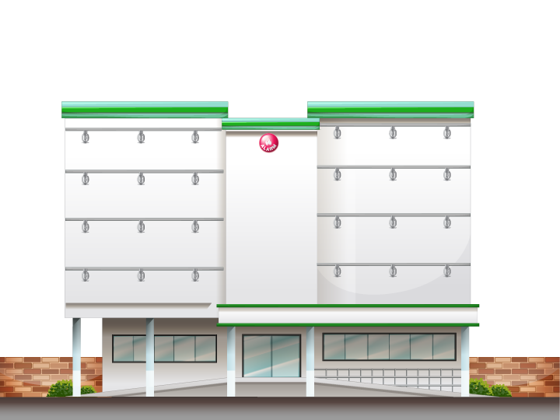
Conduct a comparative analysis with different layers of fire protection to reach the desired level of safety.
Some safety layers cost more than others.
Some safety layers provide greater protection.
Notes:
<Total Clicks: 2> Safety layers have different offerings, so use a comparative analysis.
Some safety layers provide greater protection than others – sprinklers are widely believed to be the best engineered solution, but 2/3 of reported fires in sprinklered buildings don’t grow large enough to activate the system – so, are portable extinguishers a needed layer of protection in sprinklered buildings? The data would seem to indicate they are.
<1> Some safety layers cost more than others, and with a finite amount of funding available for the construction and maintenance of buildings, it’s important to attempt to identify the most cost effective solutions to the identified risks.
<2> It’s necessary to conduct a comparative analysis of utilizing different layers of fire protection to achieve the desired level of safety is necessary. This comparison can be somewhat difficult and subjective using the current knowledge and tools available.

Slide 10


How much is enough?
Can we have too many layers?
Identify the appropriate level of safety; then utilize the most cost effective methods to achieve it.
Combining safety layers has a cumulative effect.
Will some fire protection layers interfere with the facility’s operations?
How much do
they cost?
Which layers are most effective?
What will they cost?
Notes:
<Total Clicks: 4> Identify the appropriate level of safety; then utilize the most cost effective methods available to achieve it.
All of this leads us to the real question: How much is enough?
We can probably agree that a sports arena seating 50,000 fans needs a higher level of protection than a remote, unoccupied telephone switching station, but how much more? <1> How much do they cost? And which layers are most effective?
<2> Each fire protection feature creates another layer of protection. Combining several layers of safety will usually have a cumulative effect, both in the level of safety and in cost. Quantifying those effects may be extraordinarily difficult.
<3> On the other end of the spectrum, can we have too many layers? Will some fire protection layers interfere with the facility’s operation? What will they cost?
All of these considerations should be taken into account when developing or evaluating the overall fire safety scheme for the facility.
<4> The goal is to identify the appropriate level of safety; then utilize the most cost effective methods available to achieve it.
While our model codes and standards have definitive, prescriptive requirements to achieve a particular level of safety, there may be alternative, equal or superior methods to achieve an equivalent level of safety.

Slide 11
Process Hazard Analysis
Manufacturing or hazardous processes
Quantitative Risk Analysis
Financial markets
Layers of Protection Analysis
Process hazard analysis
Fire Risk Indexing
Values assigned to various protection components
Notes:
<Total Clicks: 3> Models adapted for fire risk analysis.
There are a number of models that can be adapted to fire risk analysis; two models that are used in other industries include quantitative risk analysis and process hazard analysis.
Process hazard analysis is widely used in assessing risks to manufacturing or hazardous processes; and <1> quantitative risk analysis used in many fields, including the financial markets.
<2> LOPA, which is the acronym for Layers of Protection Analysis, is one of the tools used in process hazard analysis that can be modified for use in fire risk analysis.
<3>A simpler method than LOPA is fire risk indexing. In this model, values are assigned to various protection components (layers), and some have pass/fail criteria based upon the overall score of a given facility.
We will focus on LOPA and Fire Risk Indexing in this presentation.

Slide 12
Layers of Protection Analysis
LOPA uses fault tree analysis and other mathematical models to determine failure rates for components and systems.
01
02
03
Identifies
protection
components
04
Assesses
each component’s value
Evaluates the synergistic effects
of the layers
Compares value
to
level of risk
Notes:
<Total Clicks: 4> LOPA process.
LOPA is fairly complex. Many times it uses fault tree analysis and other mathematical models to determine failure rates for components and systems. The results of these exercises are as good as the professionals conducting the exercise, and can be very accurate and enlightening.
LOPA works by
<1> Identifying the protection components, or layers
<2> Assessing the value of each.
<3> Then, it evaluates the synergistic effects of the layers to decide the overall value of the protection system.
<4> Finally, LOPA compares the value of protection system to the acceptable level of risk for the building.
While we’ve mostly focused on the protection layers that inhibit fire growth or suppress a fire after it starts, another critical part of the analysis is the mitigation techniques that are built into the building, for example, arc fault interrupters and high limit switches on equipment. All of this must be considered to gain a clear picture of the risk.

Slide 13
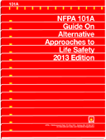
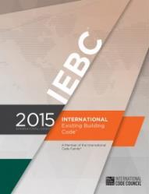
Fire Risk Indexing
Fire risk models have been developed to simplify the degree of complexity.
DO’s
Performance-based
✔
Values for each layer
✔
Easy to use
✔
DONT’s
Evaluate synergistic effects
✗
Notes:
<Total Clicks: 5> Fire Risk Indexing capabilities.
Because of the degree of complexity attached to LOPA, fire risk indexing models have been developed. These models are far simpler, and provide a level of analysis that is acceptable for most projects.
<1> Fire risk indexing uses performance as its guide for assessing risks. Typically, the tool contains set values for different layers of protection. <2> These values have been developed by experts in the field through a lot of evaluation and discussion, and are usually accepted as being relatively accurate predictors of performance.
<3> While the indexing tools are easier to use because the values are already provided, they aren’t able to evaluate <4>the synergistic effects of the different layers as well as some other, more complex models.
The most widely used fire risk indexing models are NFPA 101A, and Chapter 14 of the International Existing Building Code.

Slide 14
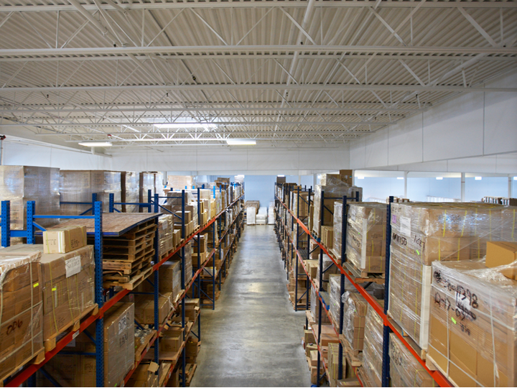
Codes and Standards
The codes and standards development process doesn’t provide for a thorough risk assessment before adding or deleting requirements.
Little scientific evidence from fire testing or other methods has been made available to the decision makers.
Codes and standards are intended to establish the minimum level of safeguards for buildings and facilities.
“Smoke and heat vents have a detrimental effect on sprinklers’ operations”
Notes:
<Total Clicks: 4> Safety layering in codes and standards.
Codes and standards use safety layering in their design.
For instance, a warehouse with high-piled combustible storage may be required to provide smoke removal or smoke and heat vents, add draft curtains, add sprinklers, and add firefighter and fire apparatus access. These are all separate and distinct layers of protection, and together, they provide the level of safety envisioned by those authoring the code.
<1> The codes and standards development process, however, doesn’t provide for a thorough risk assessment before adding or deleting requirements; this is especially problematic when one industry promotes the use of one layer at the expense of another to make the new regulation more cost effective.
During code development, many take a quick guess at risk assessment. More scientific methods would be welcome. Take our warehouse scenario, for example. <2> Some believe that smoke and heat vents have a detrimental effect on the operation of sprinklers, but if the sprinklers don’t operate effectively, interior fire suppression operations may be impossible without the vents.
<3> These issues have been debated frequently in the code development arena, but little scientific evidence from fire testing or other methods has been made available to the decision makers.
<4> Codes and standards are intended to establish the minimum level of safeguards for buildings and facilities. Some communities will add requirements to make them safer, and a few will remove requirements that they believe are unnecessary.

Slide 15


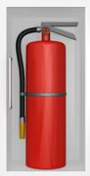


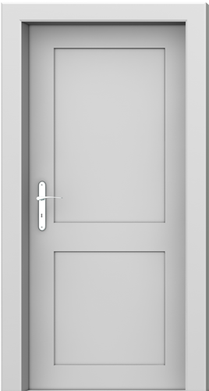


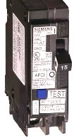
Activation
Activation layers require human intervention to activate fire protection features.
Active Suppression
Active suppression layers actively prevent the fire from spreading.
Prevention
Prevention layers prevent a fire from starting.
Passive Prevention
Passive prevention layers passively prevent the fire from spreading.
Notes:
<Total Clicks: 4> Safety layering in codes and standards.
So let’s look more closely at the safety layering concept and our codes.
Layers of safety can be divided into four general categories: prevention, activation, active suppression, and passive prevention.
<1> Prevention
Prevention layers prevent a fire from starting. Prevention is always the best outcome; a couple of the layers that contribute to prevention include arc fault interrupters and the isolation of ignition sources.
<2> Activation
Activation layers require human intervention to activate fire protection features. Features requiring human intervention include portable fire extinguishers, manual fire alarm systems, and similar features.
<3> Active Suppression
Active suppression layers actively prevent the fire from spreading. Active fire protection refers to automatic fire suppression systems, including sprinklers, kitchen hood systems, automatic fire alarm systems, automatic closing fire doors, etc. Active systems are very effective, but require regular maintenance to ensure that they will operate as intended.
<4> Passive Prevention
Passive prevention layers passively prevent the fire from spreading. Passive fire protection includes rated construction, fire barriers, fire walls, and other construction features that do not require mechanical or human intervention to perform their function. It also includes distance requirements, implemented to ensure that buildings are constructed at a safe distance from one another. These features have proven very effective, but require regular inspection to be sure that they haven’t been compromised.

Slide 16
Fire Safety Layering
We also must consider components associated with means of egress:
  Which way do the exit doors need to swing?
  Do I need panic hardware?
  Do I need exit signs?
  Do I need egress lighting?
  Can I utilize delayed egress?
  What’s my travel distance?
If we consider general safety requirements,
some of the issues might be:
  Where can I store hazardous materials?
  Can I store them next to ignition sources?
  How many hazardous materials can I have
  in a room?
  What quantity of flammable liquids can I place in a container?
  Do I need to secure that compressed gas cylinder?
Notes:
<Total Clicks: 2> Fire safety layering questions to consider.
If we consider general safety requirements, some of the issues might be:
<1> Where can I store hazardous materials?
Can I store them next to ignition sources?
How many hazardous materials can I have in a room?
What quantity of flammable liquids can I place in a container?
Do I need to secure that compressed gas cylinder?
<2> We also must consider components associated with means of egress:
Which way do the exit doors need to swing?
Do I need panic hardware?
Do I need exit signs?
Do I need egress lighting?
Can I utilize delayed egress?
What’s my travel distance?
Fire detection systems are another safeguard that can go into a building. Fire detection systems are going to detect a fire and provide for early warning along with the fire alarm system which will provide the early warning giving people more chance to safely egress the building.
And with fire suppression, we’re actually going to fight the fire automatically as people are exiting the building, providing protection to the occupants, providing a limitation on the size and spread of the fire with our suppression systems.
Fire resistive separations separate one occupancy from another, or one use from another, or one floor from another. Fire resistive construction assists in limiting the fire spread in a building.
Are there other safeguards that provide additional layers of safety in the code? Absolutely. There are many, such as interior finishes on wall surfaces: what’s the flame spread rating. So not only are we looking at what’s the fire rating of the wall, what’s flame spread rating on the covering on that wall? So we’re looking at many things in the code dealing with additional layers of fire safety in a building.

Slide 17

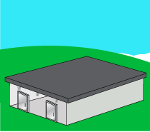
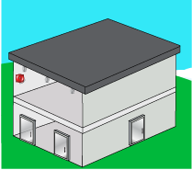



Existing Building Code Layers of Protection
Type VB
Type VA
Type IIIA
Let’s look at an example of how this concept works
4,000 ft²
20,000 ft²
50,000 ft²
1 Exit
2 Exits, Sprinklers
3 Exits, Sprinklers, Alarms
As the size of the facility changes, the risks change.
40
Each additional layer of protection is added to mitigate
that increased risk.
200
500
Notes:
<Total Clicks: 3> IBC Layers of protection.
To illustrate how this concept works, let’s examine the layers of protection of an office building required by the International Existing Building Code.
We begin with a 4,000 square foot office building, and apply Type VB construction to it. Type VB is the least restrictive building type: if you can build it, and make it stand up, you can use it. Since this building is 4000 square feet, the building is allowed an occupant load of 40. An occupant load of 40 requires one exit.
<1> Yet, if we compare that to a larger office building, such as one with 20,000 square feet, the type of construction would need to be enhanced to a greater fire resistance level, Type VA. The occupant load increases to 200, which requires two exits and fire sprinklers.
When we increased our building size, we added additional exiting, increased the fire resistance level of the type of construction, and added fire sprinklers. These additional layers of protection are required because of the increase in size and the increase in the number of people in the building.
<2> Now consider a two-story 50,000 square foot office building. It applies Type IIIA construction. This building allows us to have an occupant load of 500. As a result, this building requires three exits, a fire sprinkler system, and a fire alarm system.
When we compare the 4,000 square foot office building to the 50,000 square foot office building we see that, both are used for the same purpose: an office, but we’ve increased the fire resistance rating of the construction and the number of exits, we’ve added fire sprinklers, and we’ve added a fire alarm system. All of those are layers of protection added to the building.
<3> As the size of the facility changes, the risks change. Each additional layer of protection is added to mitigate that increased risk.

Slide 18

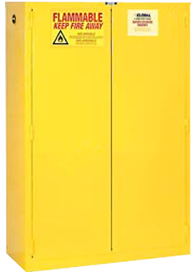

Layers of Protection in the International Fire Code
What fire safety features are associated with Class II combustible liquids?
Separate fire compartments, called controlled areas, can be built to gain another increase.
Beyond 1920 gallons the code would require the building to be a Group H occupancy.
120 gallons
240 gallons
480 gallons
1920 gallons
Notes:
<Total Clicks: 3> Layers of protection in the International Fire Code.
Consider the layers of protection in the International Fire Code. A great example is Class II combustible liquids.
What are the fire safety features that would be associated with Class II combustible liquids?
For up to 120 gallons, the fire safety requirements are that it needs to be in an approved storage container in an approved location – so, the basic building features are considered adequate if the liquids are properly stored.
If storage of up to 240 gallons is needed, fire sprinklers can be provided and the increase is allowed.
<2> We can also add an additional layer of protection in the form of approved flammable liquid storage cabinets. Now the allowed quantity increases to 480 gallons.
<3> If more than 480 gallons is needed, separate fire compartments, called control areas, can be built to gain another increase. Each control area can now have up to 480 gallons, and a building is allowed up to four control areas, for a total of 1920 gallons of Class II liquid. We haven’t changed the classification of this building, and we’ve gone from 120 gallons to 1920 gallons by adding several layers of protection.
<5> Beyond 1920 gallons, the code would require the building to be a Group H occupancy, which has even more protection requirements.

Slide 19
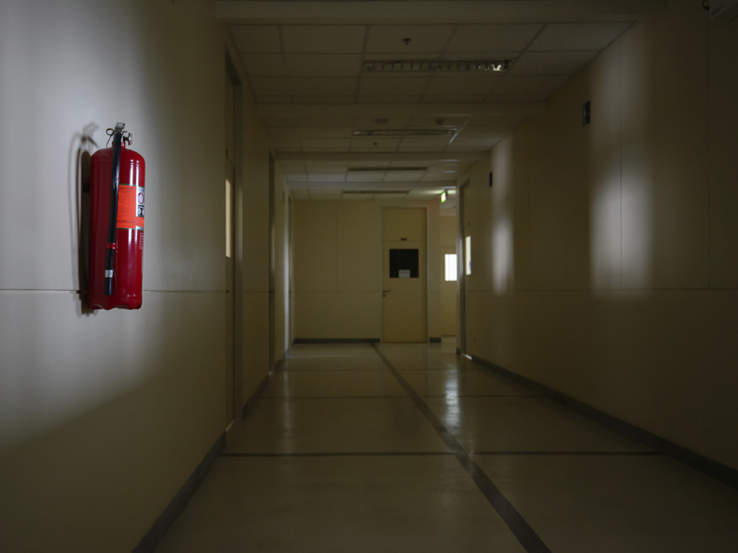
LOPA analysis should always be based upon a specific desired outcome.
LOPA considers the effect of each layer and the combined value of the overall protection scheme.
Notes:
<Total Clicks: 1> LOPA outcomes.
The LOPA analysis is specific to hazard scenarios. As we previously discussed, it should always be based upon a specific desired outcome – that is, if we don’t know where we’re going, how do we know when we’ve arrived?
<1> And while the LOPA analysis may or may not assign a specific value to a protection layer, it does consider the effect of each layer and the combined value of the overall protection scheme. The analysis should clearly show that the total value of the layers will lead to the desired outcome should a fire or other disaster occur.

Slide 20
Layers of Protection in Codes & Standards
  NFPA 101A
    Guide on Alternative Approaches to Life Safety
International Existing Building Code Performance Compliance Methods
Fire Risk Indexing
Fire Risk Analysis
Notes:
<Total Clicks: 0> NFPA and IBC’s methods in evaluating layers of protection.
Because of the complexity involved in LOPA, it is difficult, and nearly impossible to codify a building. Therefore, some of the codes and standards implement fire risk indexing as an alternative. Currently, NFPA 101A Guide on Alternative Approaches to Life Safety is an evaluation of existing buildings that utilizes a fire risk indexing process to evaluate a building’s hazards and level of life safety. Additionally, the International Existing Building Code, Chapter 14 deals specifically with performance compliance methods where a building is evaluated using a fire risk analysis based on its fire risk indexing.

Slide 21



Fire Risk Indexing
Component scores are entered into a worksheet.
Fire Risk Indexing simplifies the LOPA concept by assigning values to different safety layers.
The building’s level of fire safety is established by the final score.
A building is assessed in accordance with the particular indexing model, and the aggregate values of the protection layers are used to determine whether the building meets a predetermined level of safety.
Fire risk indexing ranking provides the ability to develop a relative fire risk where we can compare different buildings, and it is repeatable.
Is there a sprinkler system?
Is there a fire alarm system?
Do the exits comply with current code?
Notes:
<Total Clicks: 0> Explaining Fire Risk Indexing.
Because there are a variety of safeguards, it can be difficult to assess a building’s fire safety in a uniform and consistent way. Fire Risk Indexing simplifies the LOPA concept by assigning values to different safety layers. ******A building is assessed in accordance with the particular indexing model, and the aggregate values of the protection layers are used to determine whether the building meets a predetermined level of safety. The two most widely used models, NFPA and IBC, attempt to include many of the various safeguards that have an impact on the level of safety.
The fire risk indexing provides a ranking method, or a scoring method, for each of the various mitigation features. Through that specific ranking or scoring, you can develop a process that is repeatable. For example, we ask six different people to assess a building using a fire risk index. The evaluation may include “is there a sprinkler system?***** Is there a fire alarm system? ******Do the exits comply with the current code?*******” A plus score or minus score for each of those components is entered on a worksheet.****** At the end of that evaluation, at the end of the survey of that building, you add up that score. ******Based on that score, the level of fire safety in that building can be established.******* One of the advantages of fire risk indexing, is that it’s repeatable. LOPA is more subjective, and because different people look at some of these issues differently, it’s likely that each analysis will result in a different outcome.
The ranking in the fire risk indexing provides the ability to develop a relative fire risk where we can compare different buildings, and it is repeatable.

Slide 22

Fire Risk Indexing
Property Protection Classification is determined based on the community’s protection features in comparison with its risks.
What are the capabilities of the fire department?
What is the capability of the water supply?
Notes:
<Total Clicks: 2> Property Protection Classification’s use of Fire Risk Indexing.
Fire Risk Indexing is not a new concept. It’s been around for a number of years, used by a number of industries. Probably the one you’re most familiar with is the ISO rating for home insurance – known as the Property Protection Classification. Each property is evaluated based on the fire safety attributes of a community.
<1> For instance, what are the capabilities of the fire department –available apparatus, equipment on apparatus, response times, etc.?
<2> What is the capability of the water supply in relation to the buildings in the community?
Based on all of the ISO criteria you can determine the property protection classification, which becomes a component in calculating the insurance cost for a particular building. It’s a numeric process and it is very easy to repeat, very consistent, and it works for the insurance industry.

Slide 23
Glasgow Coma Scale
 | 1 | 2 | 3 | 4 | 5 | 6
Eyes | Does not open eyes | Opens eyes in response to painful stimuli | Opens eyes in response to voice | Opens eyes spontaneously | N/A | N/A
Verbal | Makes no sounds | Incomprehensible sounds | Utters inappropriate words | Confused, disoriented | Oriented, converse normally | N/A
Motor | Makes no movements | Extension to painful stimuli | Abnormal flexion to painful stimuli | Flexion / Withdrawal to painful stimuli | Localizes painful stimuli | Obeys commands
< 9 | Severe
9 to 12 | Moderate
≥ 13 | Minor
Notes:
<Total Clicks: 4> Glasgow Coma Scale example.
Another valuable example of indexing is the Glasgow coma scale, widely used to determine the brain impairment associated with an accident or other brain trauma.
The “layers” in the Glasgow Coma Scale are the function of the eyes, speech, and motor skills. Each layer is assessed and given a numerical score of 1 to 6. Once each score is tallied, they are added up to determine the level of brain impairment.
<1> In this example, the victim opens her eyes in response to someone talking to her (a score of 3);
<2> But she is not able to talk, and the sounds emanating from her are incomprehensible (a score of 2).
<3> She is not able to obey commands, but will flex or withdraw to painful stimuli (a score of 4).
<4> The total score of all three layers is 9, which, according to the scale, is in the “moderate” range of injury. This evaluation meets the goals of being relatively easy to use, providing consistent results, and being highly repeatable. These are the same goals we want to see in a fire safety indexing system.

Slide 24
Wildfires
Dow’s Fire and Explosion Index
The Mond Fire, Explosion and Toxicity Index
Evaluate archaeological sites and determine fire spread indices.
Process hazard analysis indices for the chemical and process engineering field.
Wood Frame Apartment Building Risk Analysis
Specific material hazard factors based on inventory of material and actual storage configuration of the material.
Evaluates the risk assessment in existing wood frame apartment buildings.
Fire Risk Index for Historic Buildings
Evaluates the risk assessment in existing wood frame apartment buildings.
Notes:
<Total Clicks: 4> Other Indexing applications.
Other indexing applications include many that are used in industry:
Dow’s Fire and Explosion Index which is one of the most common process hazard analysis indices that’s been specifically developed for the chemical and process engineering field.
<1> The Mond Fire, Explosion and Toxicity Index which deals with specific material hazard factors and includes quantity factors based on inventory of material and actual storage configuration of the material.
<2> There is a wood frame apartment building risk analysis which evaluates the risk assessment in existing wood frame apartment buildings.
<3> A specific Fire Risk Index for Historic Buildings developed by John Watts and Marilyn Kaplan has been used to evaluate how to maintain life safety in historic buildings and still maintain the historic quality of those buildings.
<4> We use indexing in wildfires. We evaluate archaeological sites. We determine fire spread indices. We do wildland fire planning based on indexing: what’s the slope, the temperature, the type of fuel, the wind speed and all of those criteria goes into an index to determine planning criteria for wildland firefighting.

Slide 25
Fire Safety Assessment Tools
Use layers of protection to assess the level of safety in a building.
Code Narratives
Code Descriptions
Code Commentary
Requirement Handbooks
Notes:
<Total Clicks: 4> Fire safety assessment tools.
In addition to full-blown engineering assessments, there are widely available tools to utilize that simplify the process. When we’re looking specifically at fire safety assessments, some of the available tools include
<1> code narratives,
<2> code descriptions,
<3> code commentary, and
<4> handbooks that provide explanations of the requirements and provide examples and guidance on how to apply the requirements. Checklists have been developed to review each of the layers of protection. Fire Risk Indexing provides a relatively simple mathematical analysis of the level of safety in a building. One thing all of these tools have in common is that the use of layers of protection to achieve the stated goal.

Slide 26
NFPA Building Exits Code (1924)
Fire Risk Indexing: a method for evaluating alternative fire safety configurations in existing buildings.
(A x B x C x D x E x F)
N
H
“the relation between the maximum number of persons on each floor shall be determined by the following formula…”
Notes:
<Total Clicks: 1> Equations in Indexing.
Fire risk indexing is a technique for evaluating alternative fire safety configurations in existing buildings that is intended to provide a level of flexibility to the designers in order to identify the fire protections schemes that best suit the situation. <1> The numerical values assigned to the indexing parameters are mathematically manipulated to create a single expression or a single result which provides the overall level of fire safety for the building.
Interestingly, in 1924, NFPA Building Exits Code was proposed at that time, and it included level of risk indexing. An excerpt from that code says the relation between the maximum number of persons on each floor shall be determined by a specific formula. Let’s look at that formula now; it will provide a clear example of the relationship between a few different safety factors.

Slide 27
Life Safety Code Segment
Automatic Sprinkler Protection | Value
Sprinklered | 2
Unsprinklered | 1
Units of Stair Width
1 unit = 22 inches
A
B
D
(A x B x C x D x E x F)
C
E
F
N
N
H
H
Horizontal Exits | Value
None | 2
One | 3
Two or more | 4
Risk with Occupancy | Value
Low Hazard | 3
Moderate Hazard | 2
High Hazard | 1
Protection of Vertical Openings
Construction Type | Value
Ordinary | 4
Mill or Fire Resistive | 5
Number of persons permitted on each floor above the first floor.
Stairs | Value
Open or Unenclosed | 2
Enclosed but other unprotected vertical openings | 4
Enclosed and no other unprotected vertical openings | 5
Height of the building measured in stories.
Notes:
<Total Clicks: 8> Elements of the Building Exits Code Formula.
This formula was proposed for inclusion in the Building Exits Code, which is now known as the Life Safety Code.
In this formula,
<1> the number,”N”, equals the number of persons permitted on each floor above the first floor.
<2>“A” represented the number of units of stair width, where one unit equals 22 inches.
<3>And ”B”, represented the type of construction of the building. For Ordinary construction, B equals 4. For Mill or Fire Resistive construction, B would equal 5. You can see that the type of construction and the stair width are two important factors in determining how many people are permitted above the first floor of a building.
<4>The “C” in that equation identifies the protection of vertical openings. If there were open stairs, or unenclosed stairs, the value of C would be 2. If the stairs were enclosed but there were other vertical openings that were not protected, C would equal 4. If the stairs were enclosed and there were no other unprotected vertical openings, then C would equal 5. This factor recognizes the importance of protecting vertical openings, as fire spread is known to travel most quickly through vertical shafts.
<5>The “D” in the equation represents automatic sprinkler protection: If the building is sprinklered, we get a value of 2, if the building is unsprinklered, there’s a value of 1.
<6>The “E” in the equation represented horizontal exits. If there were no horizontal exits, then E would equal 2. If there was one horizontal exit, E would equal 3. If there were 2 or more horizontal exits, E would equal 4. This factor recognizes the value of protected egress from a space.
<7>The “F” in the equation represented the risk associated with the type of occupancy. Low hazard occupancies, F would equal 3. Moderate hazard occupancies, F equals 2. And then for High hazard occupancies, F would equal 1.
<8>Finally all of those components are multiplied together and then divided by “H”. H is the height of the building measured in stories.
As you can see from this example from 1924, fire protection professionals at the time recognized myriad layers of fire safety and rated each layer based upon their judgment of the value of that particular layer.

Slide 28
Type IIA
Parameters are safeguards that serve as direct or indirect measurements of fire safety.
50,000 ft²
(
A
x
B
x
C
x
D
x
E
x
F
)
4
4
2
2
2
3
192
N
2
H
Notes:
<Total Clicks: 8> Elements of the Building Exits Code Formula.
Here is an example of how the formula is applied. Take the two story building we used earlier - 50,000 square feet total, 25,000 square feet per floor.
<1> In this case, A, our units of exit width consists of two stairs. Each stair is 44 inches wide, providing two units of exit width in each stairway, so we get a total of 4 for the value of A.
<2> B, the type of construction, in this case ordinary construction so enter a value of 4.
<3>C is the value for vertical openings. Assuming unenclosed stairs, which is allowed under this scenario connecting two stories in this building, would provide a value of 2 because the stairways are not within a rated shaft.
<4>D receives a value of 2 because sprinklers are installed.
<5>In this example, there are no horizontal exits, so enter a value of 2 for factor “E”.
<6>And because this is a low hazard building, enter a value of 3 for factor “F”.
<7> Finally, H, the height in stories, is a value of 2 for two stories.
<8> So the formula now reads: N= (4 x 4 x 2 x 2 x 2 x 3)/2 or 384 divided by 2 or 192. This is the number of people allowed on the second floor of this building. Again, this is a simple indexing formula created 90 years ago by experts at the time. There is still a great deal of validity in the concept, and we will be taking it to a new level soon.
Considering the level of safety provided, we look at what types of safeguards were included in the building. These are components of fire safety that we can use an indirect or direct measurement to determine if it is or is not provided.
<9> These are often called parameters, or index parameters within the building. Similar to layers of protection, or some could actually be called components of layers of protection but these safeguards are what we will evaluate to determine what the level of fire safety is when using our fire index.

Slide 29
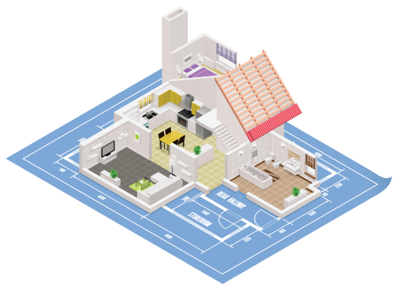
Safeguards
Considering the level of safety provided, we look at the types of safeguards in the building.
Notes:
<Total Clicks: 0> Types of Safeguards.
Some of the safeguards that we’ll evaluate in our index:
What’s the building height – the higher the building, the greater the risk.
What’s the building area – the larger the building, the greater the risk.
Are there vertical openings, and are those vertical openings protected or unprotected – unprotected openings increase the risk.
Is there an automatic suppression system or sprinkler system provided in the building – automatic suppression is often used to offset some of the risk.
Are portable fire extinguishers provided – FEs give occupants a chance to extinguish a fire while it’s still small, many times avoiding major fires.
How many exits are provided, and what’s the exit width that’s provided – the more exits, the wider the exits, the greater the opportunity for people to escape an emergency, thus reducing the risk; however, the exits need to have adequate separation to be able to serve all of the occupants of the building; If exits are too few, too narrow, or consolidated in one area, the risk would be greater.
Which direction do the exit doors swing – doors swinging opposite the direction of exit travel create significant additional risk, because people exiting the building can easily become crushed against a door that swings inward.
What’s the maximum travel distance within the building? The shorter, the better from a safety perspective.
Is there a fire alarm system providing notification to the occupants?
Is there a fire detection system providing early detection of a fire?
Does the building provide compartmentation or fire separations?
Does the HVAC system provide any benefit for smoke control or will it spread smoke and toxic gases throughout the building? Are smoke detectors included in the HVAC system duct work to shut down the units when they are conveying smoke?
Is there a smoke control system in the building?
Are there dead end corridors that could result in people unfamiliar with the egress routes being trapped in an emergency?
What’s the interior finish in the rooms, in the corridors, in the stairways?
What’s the occupancy – an office represents less risk to occupants than a nightclub.
Are the elevator controls up to code? Can the elevators be used for fire department access? Are the elevators captured and taken out of service so we don’t put occupants in jeopardy?
Are exit signs provided?
How about emergency lighting for exit pathways?
Are there any other special hazards that we need to address and consider when we’re looking at this particular building?

Slide 30
How many layers
are needed?
Which layers provide
the greatest value?
Notes:
<Total Clicks: 2> Layers required and their value.
Given the number of available layers, and the fact that they all have different costs, both in dollars and operational efficiencies, it’s worth asking the question: <1>how many layers are needed? <2>Which ones provide the greatest value, the biggest bang for the proverbial buck? Can you rank these features according to their value to the overall fire safety of a given building? Maybe sprinklers are at the top of the list, but fire resistant construction will allow interior fire suppression operations should the sprinklers fail; fire separations will allow protect-in-place strategies where needed, and a smoke exhaust system will add to the allowable egress time.
All have a role to play, depending upon the building or facility being protected.

Slide 31


Fire Sprinklers Smoke Exhaust
Do they provide an
equivalent level of safety?
Compare layers to quantify their value.
Notes:
<Total Clicks: 3> Layers required and their value.
In order to quantify the different components or layers of fire safety, it’s necessary to compare the value of one against the other. So let’s look at fire sprinklers and smoke exhaust systems. <1> Do they both provide an equivalent level of safety?
Most would answer “no”; the sprinkler system is more dependable, is designed to control or suppress the fire, while the smoke exhaust system is only intended to remove smoke from the building, which enhances egress times, but does nothing to control the fire. They both provide a benefit. Do we give them equal ranking, equal scoring? Of course not. Because that level of benefit varies between each of the various components.

Slide 32
Smoke Exhaust System
Does NOT prevent or control fires
Increases exit time
Enhances fire suppression operations
A different value for each category:
Means of Egress
General Safety
Fire Safety/Control
Where does it provide the greatest benefit?
Notes:
<Total Clicks: 3> Layers required and their value.
When considering a smoke exhaust system, where does it provide the greatest benefit.
<1> Fire Safety, or preventing fires –the smoke exhaust system does nothing to prevent fires or control the fire, so its value is virtually zero when judging its ability to prevent fires.
<2> The greatest benefit provided by smoke exhaust systems is the fact that they will increase the time for occupants to exit the building, so it definitely impacts the means of egress or time to egress.
<3> Smoke exhaust systems are called out in warehouses primarily to enhance the ability of fire suppression forces to operate within the building effectively. While there is some debate as to how effective these systems are, it is widely accepted that fire suppression activities are made significantly more difficult when copious quantities of smoke are present, making observation and movement more difficult.
<4> So when we consider the ranking, or scoring, for a smoke exhaust system, it will receive a different value based on the general category being evaluated, and would therefore receive the greatest score with regard to <5> means of egress.

Slide 33
How do we put a value on safeguards?
How does the
value change?
Give careful thought to the relative value of layers not included in IEBC or NFPA.
Are there other layers that achieve the desired results for less money?
Predetermined numbers from fire indexing:
Reliable
Consistent
Comparable
Notes:
<Total Clicks: 3> Safeguard values.
So how do we put a value on these safeguards?
<1> Fortunately, the existing indexing systems provide us with the values of many components of fire protection. The fact that the numbers are provided and predetermined allows for repeatability of this process, allows for consistent results of this process, and allows a very real and practical comparison between two buildings. And in fact can allow for a comparison of, for example, if sprinklers weren’t provided in this building: how would the value change? <2> Are there other layers that could be added to achieve the desired results for less money?
<3> A study of the values assigned to different components by the IEBC and NFPA provides an understanding of which components provide the higher, more valuable levels of safety. If someone installs components or layers that are not included in these documents, it’s important to give careful thought and consideration to the relative value of those.

Slide 34
Fire Risk Indexing
Quantitative Analysis
A definitive evaluation using numerical data; often pass/fail criteria.
01
02
03
Risks are evaluated
You don’t have to be a fire protection engineer to use an indexing tool.
Mitigation components are evaluated against risk
Report details comparisons
Qualitative Analysis
A broad and conceptual understanding of a fire protection scheme.
Notes:
<Total Clicks: 3> Fire risk indexing theory.
Fire risk indexing theory is based on a quantitative risk assessment. <1> While a qualitative analysis is useful to gain a broad and conceptual understanding of a fire protection scheme, the quantitative analysis actually provides a definitive evaluation using numerical data, and usually a pass/fail criteria for a given facility.
Comprehensive fire risk analysis theory uses aspects of management science and design analysis which is a very well established process. <2> The fire risks of the building are evaluated, using a multi-attribute decision making process. <3> The mitigation components are then evaluated against the risk profile, and <4> a report is generated detailing the results of the comparison. The building may then be deemed to meet the needs outlined in the beginning of the exercise, or the analysis may indicate additional layers of protection are needed. This process is a quantitative analysis.
The good news is that ready-to-use fire risk indexing tools are available that have already undergone substantial study and debate in determining the values, or numerical components of the formulas used. Essentially, fire risk indexing simplifies the broader theories associated with fire protection analysis and provides a useful series of calculations to use in the field. The quantitative analysis has been simplified into a qualitative analysis where you can insert values based on answers to questions. <5> You don’t have to be a fire protection engineer to use an indexing tool.

Slide 35

Fire Risk Indexing
You cannot compare an
IEBC rating with an NFPA rating
Process
Parameters
Value
Comparisons
Notes:
<Total Clicks: 1> IBC ratings and NFPA ratings are independent rating systems.
The fire risk indexing process, parameters, and values are available in IEBC Chapter 14 under Performance Compliance Methods and NFPA 101A as a Fire Safety Evaluation System.
Both are established and tested methods that provide a relative ranking or scoring for each safeguard or each parameter. Credible comparisons can be made between buildings within each system; however, .<1> credible comparisons cannot be made using the different systems, for example, comparing buildings using either the IEBC or NFPA, but mixing the two will not provide helpful or consistent results.

Slide 36
Fire Risk Indexing
Fire Safety/ Control
Means of Egress
General Fire Safety
Different hazards separated?
Fire sprinklers installed?
What type of construction?
Size and amount of exits?
Dead-end corridors?
Maximum travel distance?
What are the interior finish and flame spread requirements?
Vertical openings?
Fire alarm systems?
Attributes often overlap categories.
Notes:
<Total Clicks: 4> Fire Safety and Control, Means of Egress, and General Fire Safety
Fire Risk Indexing evaluates safeguards in three categories: fire safety, means of egress, and general fire safety.
<1> When assessing fire safety features we check to see if different hazards are separated, if fire sprinklers are installed, or examine the type of construction.
<2> Means of egress evaluations include exits in terms of amount and size. In addition, it may ask if any dead-end corridors are provided or identify the maximum travel distance.
<3> In the last, and most broad category, general fire safety, we review items such as interior finish and flame spread requirements, vertical openings and their protection, and fire alarm systems.
Both the IEBC and NFPA evaluate buildings within these same three categories.
<4>It is important to know that, while we may be able to assign a particular attribute to one of the categories, most often the attributes overlap between categories, so the categories aren’t really critical to the utilization of the indexing tool. Recommend deleting

Slide 37
IEBC Fire Risk Indexing
Fire Safety
The score for each value is relative to its category.
Means of Egress
General Fire Safety
Notes:
<Total Clicks: 1> IBC Fire Risk Indexing.
In the IEBC, the evaluation is specific to certain fire safety parameters, which are scored based on their impact to each category.
As a result the following questions are asked:
How do fire sprinklers improve the level of fire safety?
How do fire sprinklers impact the means of egress?
And, how do fire sprinklers enhance the level of general safety?
Remember, many of the fire protection components will overlap one or more of the categories, and the score for each attribute will reflect the relative value of the component in each category.
<1> When all of the components are evaluated, the score for each category will be compared to that in the code to determine whether the fire protection scheme meets the minimum fire safety criteria for existing buildings.

Slide 38
IEBC Fire Risk Indexing
Type IIIA Construction
Type IIA
Minimum Scores
Fire Safety
30
Means of Egress
40
50,000 ft²
Meeting the minimum requirements of IEBC Chapter 14 does not mean it complies with the code for new construction.
General Fire Safety
40
The minimum acceptable score must be met in each category.
Notes:
<Total Clicks: 5> IBC Fire Risk Indexing.
Let’s consider our 2-story, 50,000 square feet office building, 25,000 square feet per floor office building example.
When using IEBC, the building must meet the minimum mandatory safety score at the end of the evaluation.
In this case, the building is a Group B occupancy, where the building must meet a <1> fire safety rating of 30, <2>means of egress score of 40, and a <3> general safety score of 40.
If the building meets or exceeds the minimum scores in each category, then the building is considered to meet the acceptable level of fire safety. <4> However, it does not mean that it complies with the current code; it meets the minimum acceptable level of safety for that existing building.
<5>The minimum acceptable score must be met in each category. While a building might achieve excess points in one of the categories, it still must meet the minimum in the other two in order to be deemed compliant.

Slide 39

NFPA Fire Risk Indexing
Fire Control
Means of Egress
General Fire Safety
Negative, positive, or pass/fail scores are aggregated to assess compliance.
Notes:
<Total Clicks: 1> NFPA Fire Risk Indexing
Using NFPA 101A is similar to using the IEBC tool, in that it uses a scoring system to determine the overall level of safety in a building, and compares that score to a predetermined level that a committee has deemed appropriate.
It also uses three categories to describe components:
Fire Control
Means of Egress, and
General Fire Safety
<1> And, as with the IEBC tool, the risk and the mitigation components are scored. For instance, a negative score may be given to a building with unprotected vertical openings, and a positive score will be given for a rated enclosure. There are also criteria listed in NFPA 101A that are simply “yes” or “no”; these are considered pass/fail criteria, with no numerical score, but the building must have certain safeguards.
For components that are scored, each is given the appropriate positive or negative score, then aggregated in the appropriate worksheet to determine if a particular category is compliant. Then, the worksheets are compiled to determine if the building meets the minimum requirements of NFPA 101A.
To clarify, the scores must be achieved in each of the categories; while a building might achieve excess points in one of the categories, it still must meet the minimum in the other two in order to be deemed compliant.

Slide 40
NFPA Fire Risk Indexing
Type II (111) Construction
Minimum Scores
Type II (111)
Fire Control
-1
Means of Egress
0
50,000 ft²
General Fire Safety
-1
Meeting the minimum requirements of 101A does not mean it complies with the code for new construction.
Notes:
<Total Clicks: 4> NFPA Fire Risk Indexing
We’ll apply the same scenario for NFPA 101A: a 2-story office building, 50,000 square feet with 25,000 square feet per floor.
NFPA 101A provides different parameters for existing and new construction. In this evaluation, we’ll use existing building criteria. The height of the building is one of the basic criteria upon which all of the requirements are based, and it’s measured in stories.
<1> In this case, a 2 story building requires a fire control score of “-1” or higher; <2> a means of egress score of “0” or higher, and for <3> general fire safety a value of “-1” or higher.
In this building, with a construction type of unrated combustible, its construction score is “-1”; if its stairs are not enclosed, the score for vertical openings is a ”-2”. These two items alone would cause the building to fail (the score would be “-3”, and the mandatory minimum requirement is “-1”). So, mitigation measures must be considered.
In this case, enclosing the stairs with one hour construction changes the vertical openings score from a ”-2” to “1”, which changes the total score for these two components to zero, which is compliant.
<4> Meeting the minimum requirements of 101A does not mean it complies with the code for new construction.

Slide 41
NFPA or IEBC?
Either.
Both methods:
Evaluate and identify values for safeguards
Report on the combined levels of safeguards in existing buildings
Notes:
<Total Clicks: 0> NFPA or IBC?
The approach is different for both the NFPA and IEBC method.
Which method should you use?
Either.
Both methods:
evaluate specific safeguards and identify a value for that safeguard
provide an evaluation of the combined level of safeguards in existing buildings
as a standalone evaluation will work.
You will come up with different values in each process. You cannot compare the values of one to the values of the other. But when you select one approach you go through that approach and determine t he level of acceptable safety in that building. Neither method is right. Neither method is wrong. Two different approaches to solving the same problem.

Slide 42
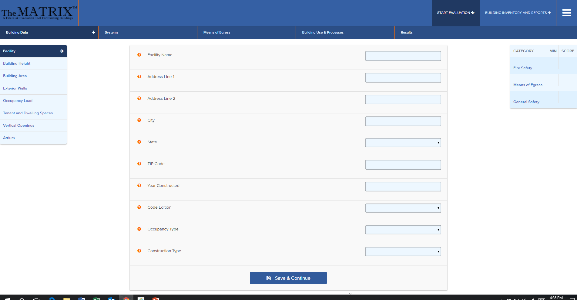
The NASFM Foundation Risk Evaluation MATRIXTM streamlines an existing building evaluation.
Notes:
<Total Clicks: 0> IBC and NFPA app
While both the IEBC method and the NFPA method are equally valid, the NASFM Fire Research and Education Foundation has developed a computer application (app) to assist you in working through the existing building evaluation process. The app is based on IEBC Chapter 14, with an eye toward usability in simplifying the building evaluation based on the specific criteria required in Chapter 14.
The app guides you through the process. Step-by-step the app will ask for information about the building, such as is the building protected with a fire sprinkler system; does the building have a fire alarm system. You provide the appropriate data from your building review. The app will compile all of the data and provide an output as to the safety rating of the building.

Slide 43
Summary
Fire safety assessment
Safety layering
Fire risk indexing
Fire risk indexing methods
  IEBC Chapter 14 Performance Compliance Methods
  NFPA 101A Chapter 8 Fire Safety Evaluation System
Notes:
<Total Clicks: 0> NFPA or IBC?
So in summary, we have looked at basic concepts of fire safety or fire risk assessment as a method to determine the level of fire and life safety in any given building. These assessments are important in determining a community’s overall fire risk.
An important concept in providing a safe environment is redundancy, which we refer to as safety layering. Because there is no single fire safety component that addresses all of the fire risks completely, it’s necessary to provide several layers of protection to achieve the goal; the greater the risk to people or property, the more layers of safety needed.
Fire risk indexing is a simplified method to assess the overall risk in any given building; a number of ready-to-use tools are available for this purpose, and each tool provides a means to compare the level of safety in one building to another, and to determine whether a building provides a particular level of safety.
In this course, the two most common fire risk indexing applications have been described, those are contained in the International Existing Building Code, Chapter 14, and NFPA 101A. While these tools use different scoring systems, the concepts are virtually identical. A building’s risks and mitigation measures are given either pass/fail or numerical scores. Those scores are then compared with numerical values that have been developed through a consensus process and deemed to provide an appropriate level of safety.
We have only considered existing buildings in the presentation, but both NFPA and the ICC provide both prescriptive and performance criteria for new construction as well.

